Slide 1
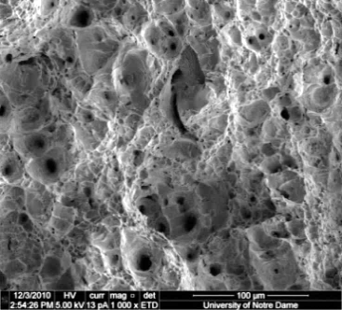

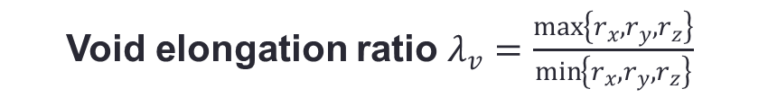







Micromechanics: Computational Cell
$$z$$
$$r_{z}$$
$$V_{v}^{0} =0.01$$
Microstructure idealization
Modeling idealization
$$x$$
$$y$$
$$r_{x}$$
$$r_{y}$$
Ductile fracture
Array of voids
Computational cell
Finite element model
Void volume fraction $V_{v}=\frac{void volume}{cell volume}$
Void elongation ratio $λ_{v}=\frac{\max\left\{r_{x},r_{y},r_{z}\right\}}{\min\left\{r_{x},r_{y},r_{z}\right\}}$
| 7 |

Slide 2

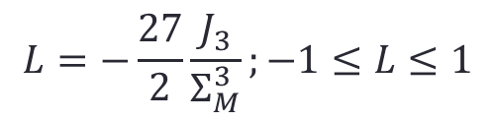





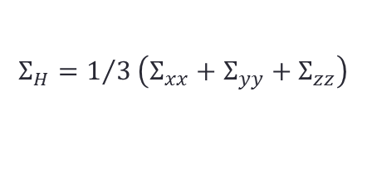

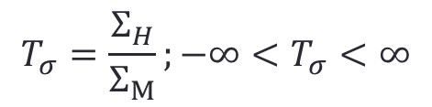

Micromechanics: Stress State
Macroscopic stresses:
$Σ_{xx},Σ_{yy} and Σ_{zz}$ are area averages
$$T_{σ}=\frac{Σ_{H}}{Σ_{M}};−∞<T_{σ}<∞$$
$$Σ_{yy}$$
Triaxiality:
$Σ_{H}−$ Hydrostatic stress; $Σ_{M} −$Von-Mises stress
$$Σ_{H}=1/3\left(Σ_{xx}+Σ_{yy}+Σ_{zz}\right)$$
$$Σ_{M}=\sqrt{Σ_{xx}^{2}+Σ_{yy}^{2}+Σ_{zz}^{2}−(Σ_{xx}^{}Σ_{yy}^{}+Σ_{xx}^{}Σ_{zz}^{}+Σ_{zz}^{}Σ_{yy}^{})}$$
$$Σ_{xx}$$
$$Σ_{zz}$$
$$y$$
$$L=−\frac{27}{2}\frac{J_{3}}{Σ_{M}^{3}};−1≤L≤1$$
$$x$$
Lode parameter:
$$z$$
$J_{3} −$third invariant of deviatoric stress
$$J_{3}=−\frac{1}{27}\left(Σ_{xx}+Σ_{yy}−2Σ_{zz}\right)\left(Σ_{yy}+Σ_{zz}−2Σ_{xx}\right)\left(Σ_{xx}+Σ_{zz}−2Σ_{yy}\right)$$
The influence of Lode parameter is negletted in this study – it is not possible to obtain a wide range of Lode parameters when working with sheet metal

Slide 3






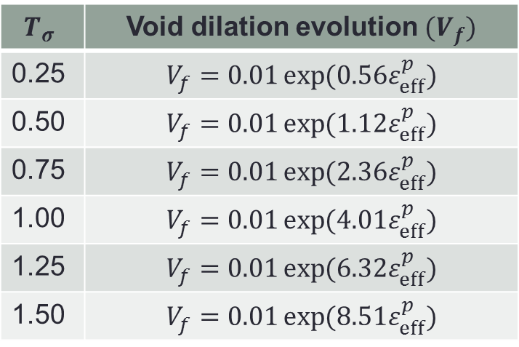


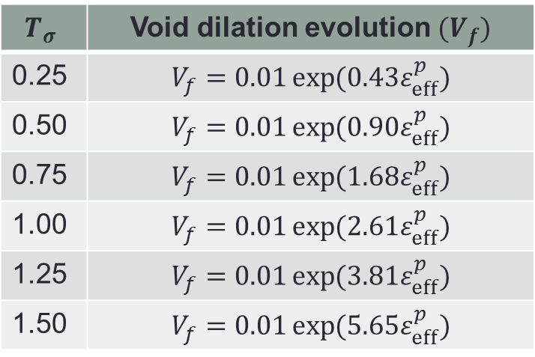




Void Dilation Equations
Ferrite
$$T_{σ}=1.5$$
$$T_{σ}=1.5$$
$$1.25$$
$$1.25$$
Martensite
$$1.0$$
$$0.75$$
$$1.0$$
$$0.75$$
$$0.25$$
$$0.5$$
$$0.5$$
$$0.25$$
$$T_{σ}$$ | Void dilation evolution $(V_{f})$
0.25 | $$V_{f}=0.01\exp{(0.43ε_{eff}^{p})}$$
0.50 | $$V_{f}=0.01\exp{(0.90ε_{eff}^{p})}$$
0.75 | $$V_{f}=0.01\exp{(1.68ε_{eff}^{p})}$$
1.00 | $$V_{f}=0.01\exp{(2.61ε_{eff}^{p})}$$
1.25 | $$V_{f}=0.01\exp{(3.81ε_{eff}^{p})}$$
1.50 | $$V_{f}=0.01\exp{(5.65ε_{eff}^{p})}$$
$$T_{σ}$$ | Void dilation evolution $(V_{f})$
0.25 | $$V_{f}=0.01\exp{(0.56ε_{eff}^{p})}$$
0.50 | $$V_{f}=0.01\exp{(1.12ε_{eff}^{p})}$$
0.75 | $$V_{f}=0.01\exp{(2.36ε_{eff}^{p})}$$
1.00 | $$V_{f}=0.01\exp{(4.01ε_{eff}^{p})}$$
1.25 | $$V_{f}=0.01\exp{(6.32ε_{eff}^{p})}$$
1.50 | $$V_{f}=0.01\exp{(8.51ε_{eff}^{p})}$$

Slide 4


Void Dilation Equations[Contd.]
$$P_{F}=0.31\exp{(2.01T_{σ})}$$
$$P_{M}=0.38\exp{(2.21T_{σ})}$$
Ferrite
Martensite
Void dilation equation: Ferrite
${\dot{V}}_{f}=0.01P_{F}\exp{(P_{F}ε_{}^{eff})}{\dot{ε}}_{}^{eff};$ where $P_{F}=0.31\exp{(2.01T_{σ})}$
Void dilation equation: Martensite
${\dot{V}}_{f}=0.01P_{M}\exp{(P_{M}ε_{}^{eff})}{\dot{ε}}_{}^{eff};$ where $P_{M}=0.38\exp{(2.21T_{σ})}$

Slide 5














Void Elongation Equations
$$T_{σ}=0.25$$
$$T_{σ}=0.25$$
$$0. 5$$
$$0. 5$$
$$0.75$$
$$0.75$$
$$1.0$$
$$1.25$$
$$1.0$$
$$1. 5$$
$$1.25$$
$$1. 5$$
Ferrite
Martensite
1) Micro void elongation is prominent at low triaxialities for both ferrite and martensite
2) The void in ferrite tend to elongate rapidly when compared to the void in martensite for a given macroscopic strain at high triaxialities
3) The evolution of void elongation ratio is almost linear (similar to the evolution of void dilation) with respect to the macroscopic strain
$${\dot{λ}}_{v}=M\left(T_{σ}\right){\dot{ε}}^{eff}$$
$M\left(T_{σ}\right)$- Proportionality constant

Slide 6


Void Elongation Equations[Contd.]
$$M\left(T_{σ}\right)=−1.46T_{σ}+3.58$$
$$M\left(T_{σ}\right)=−2.39T_{σ}+4.01$$
Ferrite
Martensite
Evaluating proportionality functions
The proportionality functions are obtained by plotting slopes of void elongation evolution curves with respect to the triaxialities at which they are obtained

Slide 7
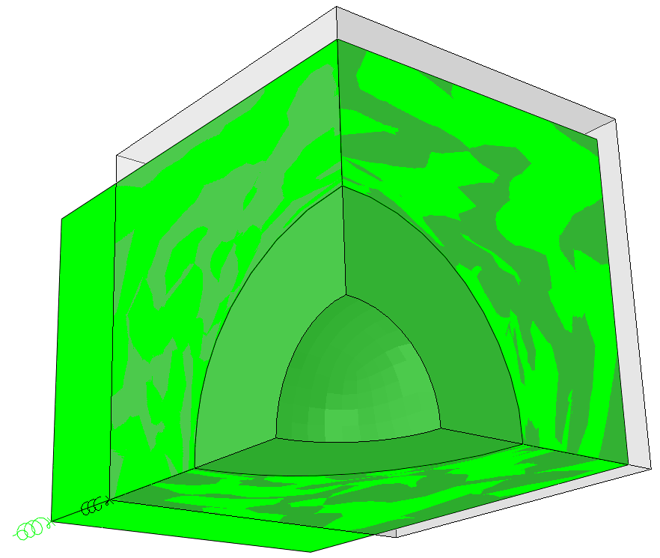
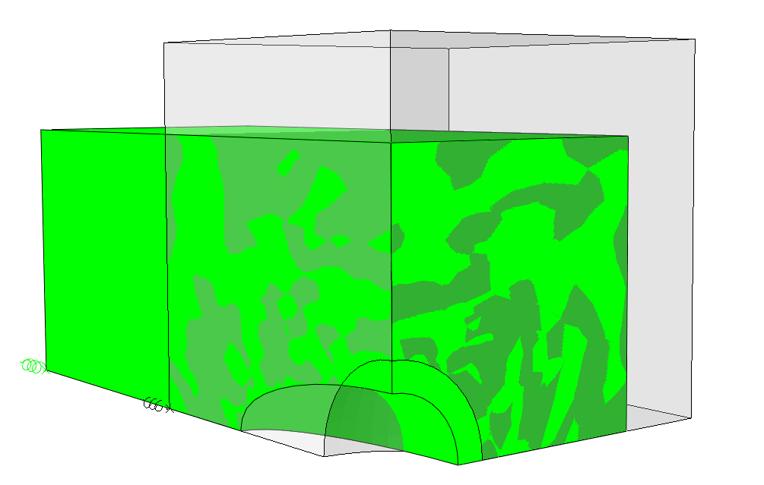


Microscopic Damage Mechanisms
$$T_{σ}=2;L=−1$$
$$T_{σ}=0.3;L=−1$$
undeformed cell
deformed cell
dilated void
initial void
initial void
elongated void
Void Dilation
Void Elongation
Coalescence of dilated voids
Coalescence of elongated voids

Slide 8






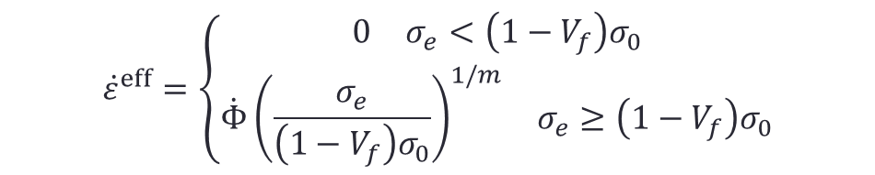

Modified LeMaitre Model
Stress rate and elastic strain rate
$${\dot{σ}}_{ij}=C_{ijkl}{\dot{ε}}_{kl}^{e}$$
$C_{ijkl}$- elastic moduli of un-damaged material
Isotropic visco-plastic constitutive equation
$${\dot{ε}}^{eff}=\left\{\begin{matrix}\begin{matrix}0 & σ_{e}<\left(1−V_{f}\right)σ_{0}\end{matrix} \\ \begin{matrix}\dot{Φ}{\left(\frac{σ_{e}}{\left(1−V_{f}\right)σ_{0}}\right)}^{1/m} & σ_{e}≥\left(1−V_{f}\right)σ_{0}\end{matrix}\end{matrix}\right.$$
Damage evolution equation
$${\dot{V}}_{f}=\left\{\begin{matrix}\begin{matrix}0.01P_{F}\exp{(P_{F}ε_{}^{eff})}{\dot{ε}}^{eff};P_{F}=0.31\exp{(2.01T_{σ})} & V_{f}<V_{fcr} and & λ<λ_{cr}\end{matrix} \\ \begin{matrix}(0.01P_{F}\exp{(P_{F}ε_{}^{eff})}{+p_{3}\exp{(p_{4}ε^{eff})}}){\dot{ε}}^{eff} & V_{f}≥V_{fcr}\end{matrix} or λ≥λ_{cr}\end{matrix}\right.$$
$p_{3}$, $p_{4}$ are void coalescence parameters
$V_{fcr}$ critical damage parameter
$λ_{cr}$ critical void elongation ratio
Void elongation evolution
$$\dot{λ}=\left(−A_{1}T_{σ}+B_{1}\right){\dot{ε}}^{eff}$$
$A_{1}$, $B_{1}$ are void elongation parameters

Slide 9
Modified LeMaitre Model: Features
Features
1) The model accounts for the damage due to microvoid dilation and elongation based on damage evolution equations derived from micromechanical analysis
2) While the microvoid dilation can cause gradual local softening, microvoid elongation is assumed to cause damage only when the critical void elongation ratio is exceeded
3) The model can be used to identify the actual damage mechanism (microvoid dilation/ elongation) that ultimately initiates fracture
Limitations
1) The model does not account for the local anisotropy induced by microvoid elongation
2) The influence of microvoid rotation is ignored.

Slide 10
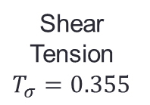




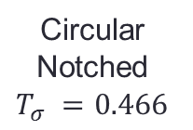


Q&P980 Fracture Tests
Aim: to understand the influence of triaxiality on fracture strains of Q&P980 steels and thereby use this information for calibrating $V_{fcr}$ and $λ_{cr}$
Shear
Tension
$$T_{σ}=0.355$$
Circular
Notched
$$T_{σ} =0.466$$
Pure Shear 2
$$T_{σ}=0.08$$
U-notch
$$T_{σ} =0.53$$
Pure Shear 1
$$T_{σ}=0.1$$
$$T_{σ}=0$$
$$T_{σ}=0.33$$
$$T_{σ}=0.66$$
$T_{σ}−$ average triaxiality in the critical cross-section (least cross-sectional area)
Specimens used for calibration of MLM

Slide 11
Load Displacement Curves
Displacement rate – 0.02 mm/sec; DIC is use to acquire strain data (5 fps)
Three tests for each geometry are tested
Good repeatability of load displacement behavior and fracture strains are obtained

Slide 12

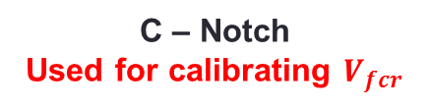
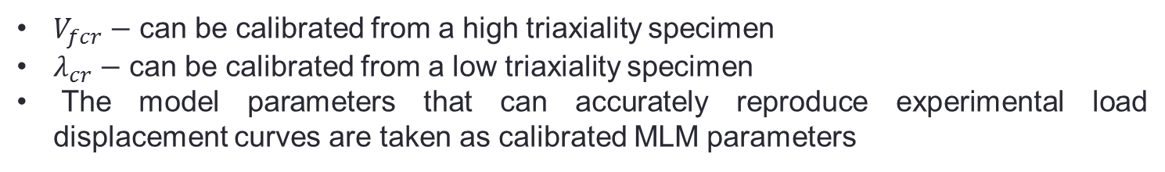

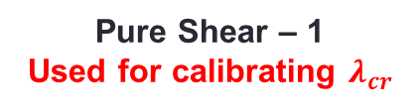
MLM Calibration
$V_{fcr}−$ can be calibrated from a high triaxiality specimen
$λ_{cr}−$ can be calibrated from a low triaxiality specimen
The model parameters that can accurately reproduce experimental load displacement curves are taken as calibrated MLM parameters
$$V_{fcr}=0.0055$$
MLM
Experiment
C-Notch
C – Notch
Used for calibrating $V_{fcr}$
$$λ_{cr}=2.7$$
Pure Shear – 1
Used for calibrating $λ_{cr}$

Slide 13







MLM: Load Displacement Prediction
C-Notch
U-Notch
Pure Shear - 1
MLM
Experiment
Pure Shear - 2
Shear Tension
$$V_{fcr}=0.0055$$
$$λ_{cr}=2.7$$

Slide 14



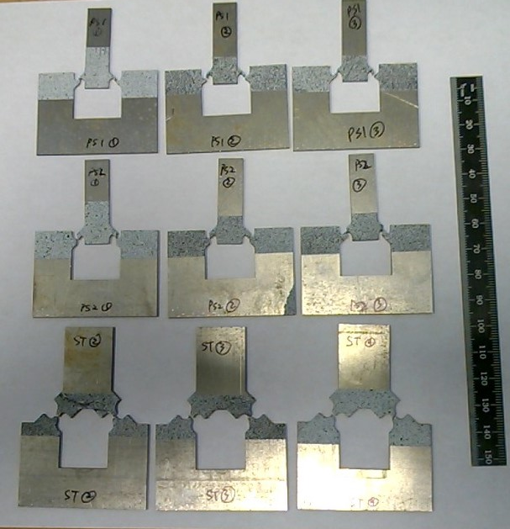
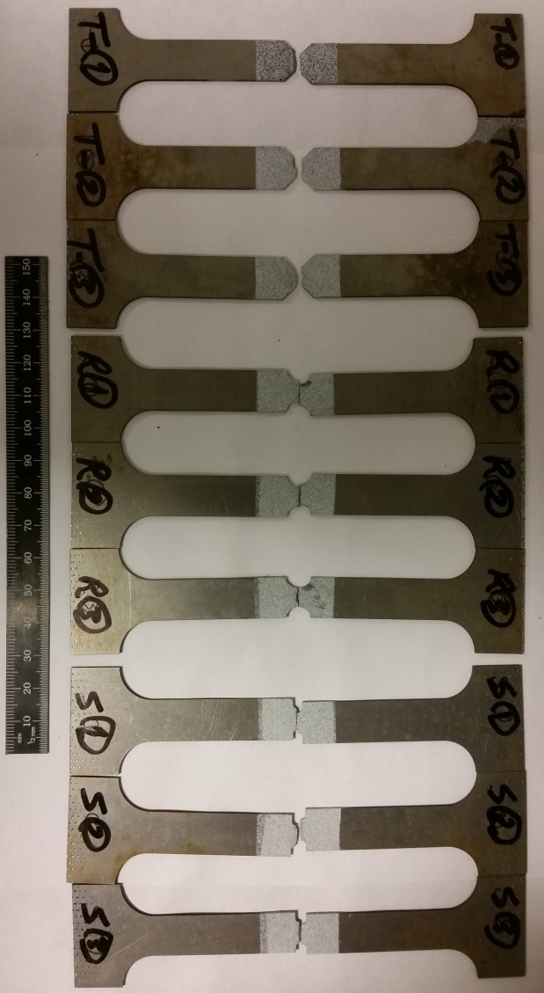
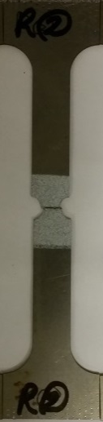
MLM: Fracture Initiation Locations
C-Notch
U-Notch
Pure Shear - 1
Pure Shear - 2
Shear Tension

Slide 15


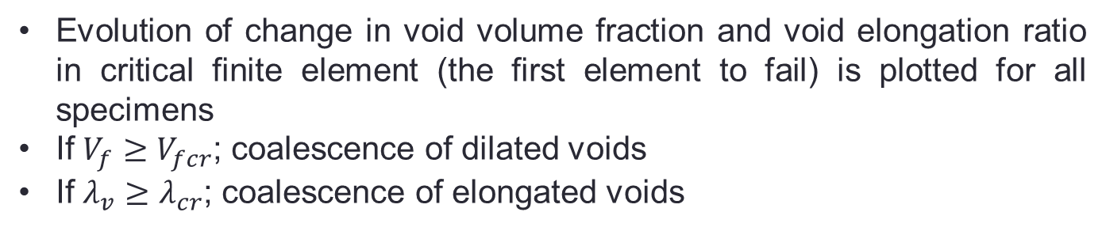

MLM: Microscopic Damage Mechanisms
Evolution of change in void volume fraction and void elongation ratio in critical finite element (the first element to fail) is plotted for all specimens
If $V_{f}≥V_{fcr}$; coalescence of dilated voids
If $λ_{v}≥λ_{cr}$; coalescence of elongated voids
$$V_{fcr}=0.0055$$
$$λ_{cr}=2.7$$
C – Notch
Used for calibrating $V_{fcr}$
Failure initiates in C-Notch due to coalescence of dilated microvoids

Slide 16





MLM: Microscopic Damage Mechanisms[Contd.]
$$V_{fcr}=0.0055$$
$$λ_{cr}=2.7$$
Failure initiates in U-Notch due to coalescence of dilated and elongated microvoids
U-Notch
$$V_{fcr}=0.0055$$
$$λ_{cr}=2.7$$
Pure Shear – 1
Used for calibrating $λ_{cr}$
Failure initiates in PS-1 due to coalescence of elongated microvoids

Slide 17




MLM: Microscopic Damage Mechanisms[Contd.]
$$V_{fcr}=0.0055$$
$$λ_{cr}=2.7$$
Pure Shear - 2
Failure initiates in PS-1 due to coalescence of elongated microvoids
$$V_{fcr}=0.0055$$
$$λ_{cr}=2.7$$
Shear Tension
Failure initiates in U-Notch due to coalescence of dilated and elongated microvoids

Slide 18
MLM: Specimen Fracture Locus
A
11.2 mm
A
A
A
11.2 mm
Critical cross-sections
Experiment
MLM prediction
Gage lengths
Experimental result match with MLM prediction
Relative displacement $−\frac{Δl}{l};Δl−$ change in length; $l−$ gage length (11.2 mm)
Average initial triaxiality – average triaxiality in the critical cross-section A-A (least cross-sectional area shown in the schematics – left side)

